Slide 1
Cloud Computing
SEWP ZG527

Slide 2



Hadoop
Name of the elephant!!
Notes:
RL 8.1

Slide 3





Or have u thought of the following?
How do “big bazaar/more/D’Mart” target promotions guaranteed to make you buy?
How can Airtel(4G) increase Ad-campaign efficiency?
What’s in your search? How is Google able to make such good predictions about your search?
I have huge amount of data(nw sites) data(twitter) data(blog) data(feeds) data(forums) ? What do I do with it?

Slide 4
Wow, that’s so much of DATA to process!!!
: exactly, and that what we call as ”BIG Data”
Hadoop is one of the best-known cloud platforms for big data today
It solves a specific class of data-crunching problems that frequently comes up in the domain of Internet computing and high-performance computing.
Managing lots of information (growing by the day and doubling by year)
Working with many new types of data (totally unstructured)

Slide 5
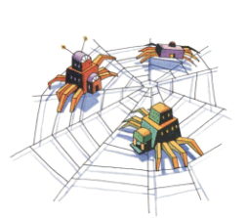

One of the research in the year 2012, Hadoop held the world record for the fastest system to sort large data (500 GB of data in59 sec and 100 terabytes of data in 68 seconds)
Designed to answer the question: “How to process big data with reasonable cost and time?”
Okay, okay…. Sit tight,
Super, so tell me more about Hadoop, the data cruncher

Slide 6
Hadoop Features
Hadoop is optimized for batch-processing applications, and scales to the number of CPUs available in the cluster
Provides Framework for Massive parallel processing
Programmer can focus on their program, and the framework takes care of the details of parallelization, fault-tolerance, locality optimization, load balancing
Paradigm shift: In MapReduce programming model, computation goes to data rather than data coming to program. Processing takes place where data is.

Slide 7
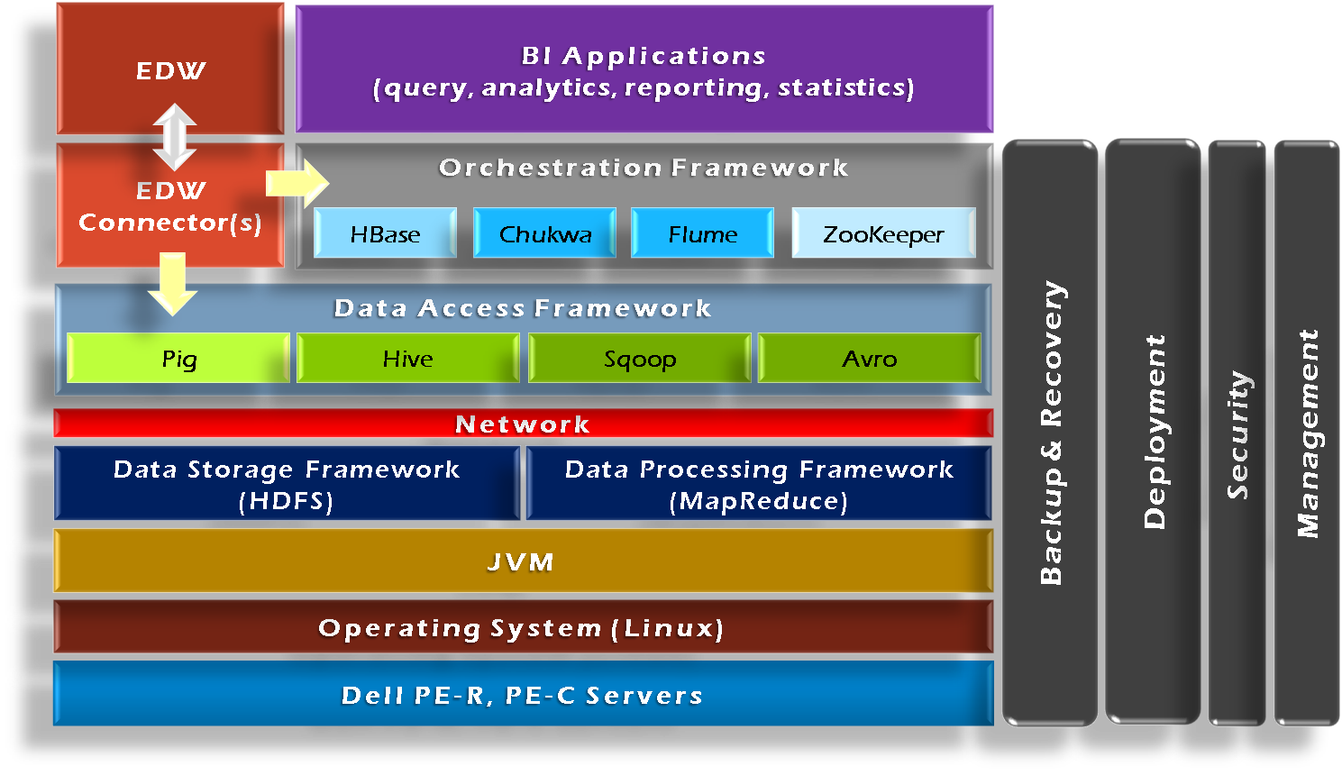
Hadoop Framework Tools

